Slide 1

Exam AZ-305: Designing Azure Infrastructure Solutions Crash Course
Tim Warner

Slide 2

Tim Warner
Principal Author, Pluralsight
Based in Nashville, TN, US
Former Microsoft FTE and MVP; 26-year MCT
Email: tim-warner@pluralsight.com
Badge: TechTrainerTim.com

Slide 3
Agenda
Introduction
Design identity, governance, and monitoring solutions (25–30%)
Design data storage solutions (20–25%)
Design business continuity solutions (15–20%)
Design infrastructure solutions (30–35%)Exam AZ-305 strategy

Slide 4
Course Materials
timw.info/az305

Slide 5
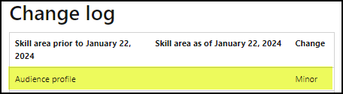
Exam AZ-305: January 2024 Changes
The Microsoft Azure solutions architect:
Designs cloud solutions: Translates business needs into technical plans for cloud and hybrid environments running on Microsoft Azure
Serves as SME in key Azure components: Possesses a deep understanding of Azure services including compute, network, storage, monitoring, and security
Collaborates with their team: Works closely with a variety of tech roles like developers, administrators, security experts, and data engineers to bring solutions to life
Advocates Microsoft's Well-Architected Framework: Ensures designs follow Azure best practices with an emphasis on reliability, efficiency, and cost-effectiveness
Demonstrates strong IT operations and DevOps skills: Has advanced knowledge in networking, virtualization, identity, security, continuity, disaster recovery, data platforms, and governance

Slide 6
Level Setting
We'll learn by doing – majority demo
Visual, case study approach
This is an expert certification, so we move quickly and assume intermediate-level Azure skills
I’m here to answer your questions – take advantage of this!
Please use the Q&A panel for questions and feedback

Slide 7
Break Schedule (CT, Nashville, TN)
06:30am - Soundcheck
07:00am - Start
08:00am - 8-min break
09:00am - 8-min Break
10:00am - 8-min Break
11:00am - 8-min Break
11:40am - Landing zone
12:00pm - Finish

Slide 8
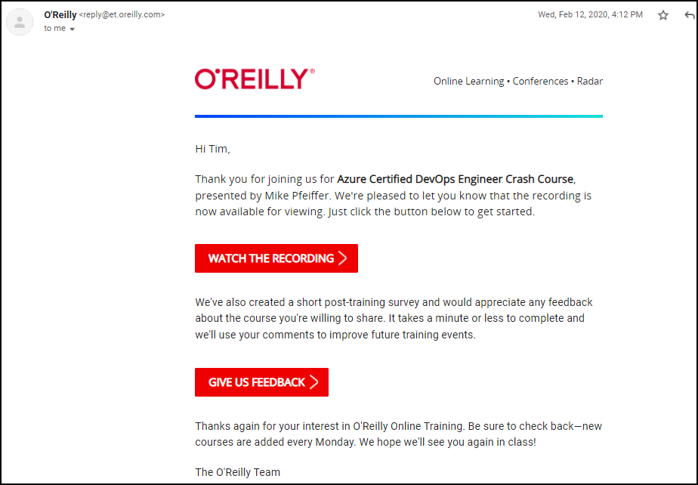
Session Recordings

Slide 9

Session Recordings

Slide 10

Session Recordings

Slide 11

Session Recordings

Slide 12


Mobile Browser: learning.oreilly.com

Slide 13



O'Reilly Mobile App

Slide 14
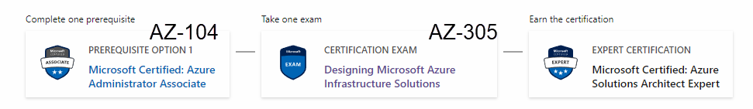
Azure Solutions Architect Expert
One-year validity

Slide 15

Tim's Certification Study Model

Slide 16
Critical Microsoft Docs Sites
Cloud Adoption Framework (CAF)
Well-Architected Framework (WAF)
Azure Architecture Center (AAC)

Slide 17
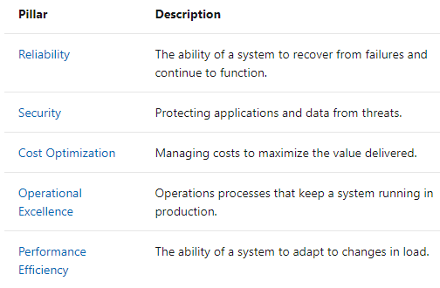
Microsoft Well-Architected Framework

Slide 18
Thank you!
Course materials: timw.info/az305
Email: tim-warner@pluralsight.com
Work: timw.info/ps
LinkedIn: timw.info/li

Slide 19

Azure Monitor

Slide 20

Log Analytics

Slide 21

Sentinel

Slide 22
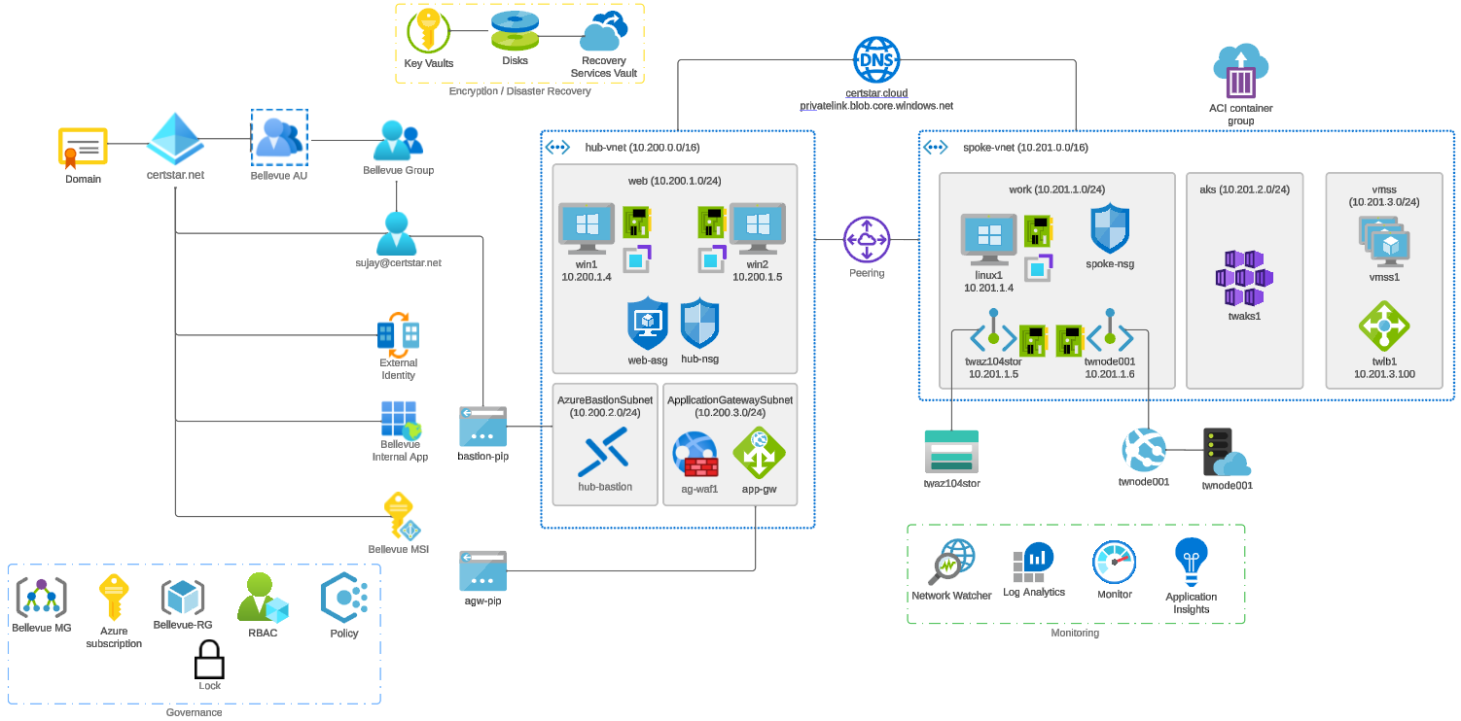


Slide 23

Tenant vs. Subscription

Slide 24

Hybrid Identity

Slide 25

Azure AD B2C

Slide 26
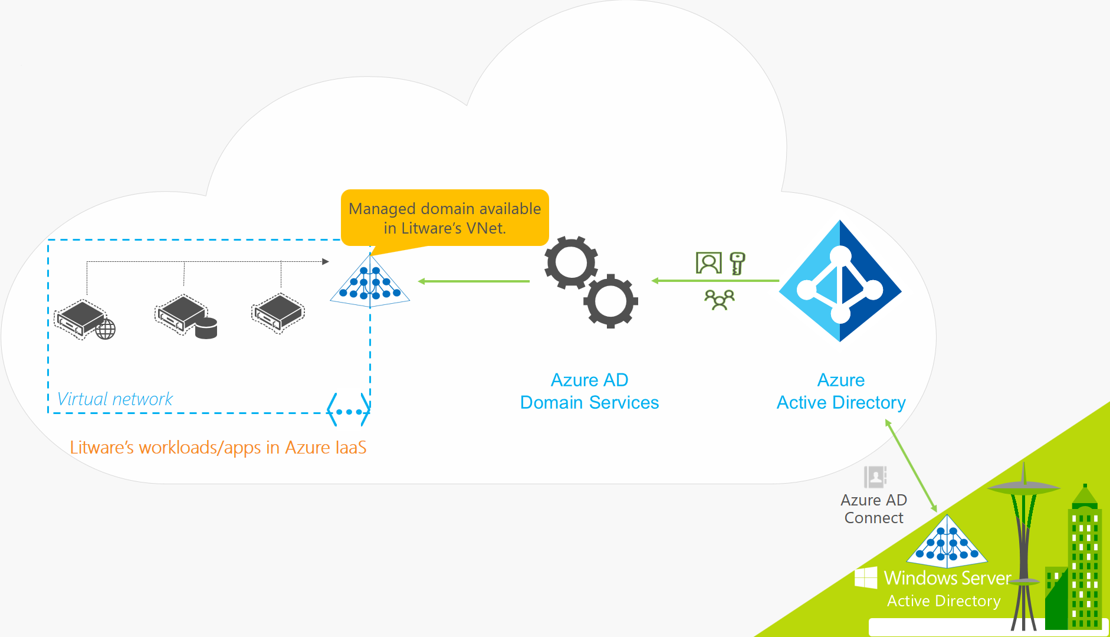
Azure AD Domain Services

Slide 27

Pass-through Authentication

Slide 28

Seamless Single Sign-on

Slide 29

Azure Management Scopes
/ Tenant Root

Slide 30
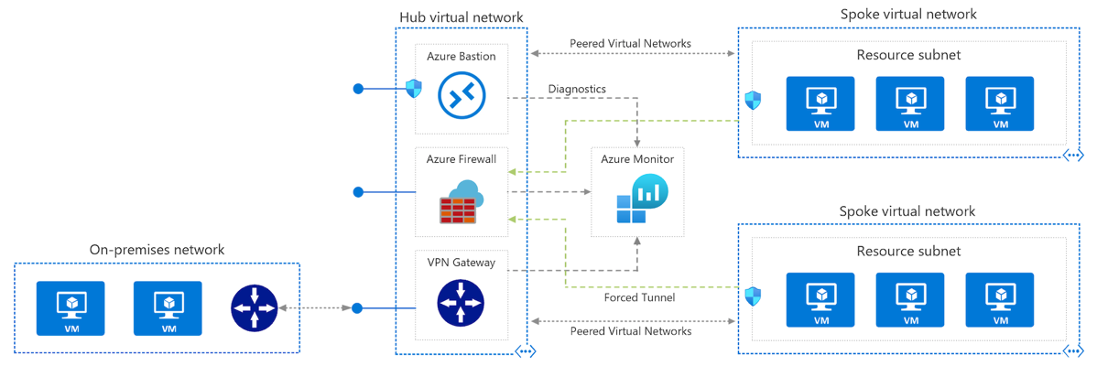
Azure VNet Hub-Spoke

Slide 31
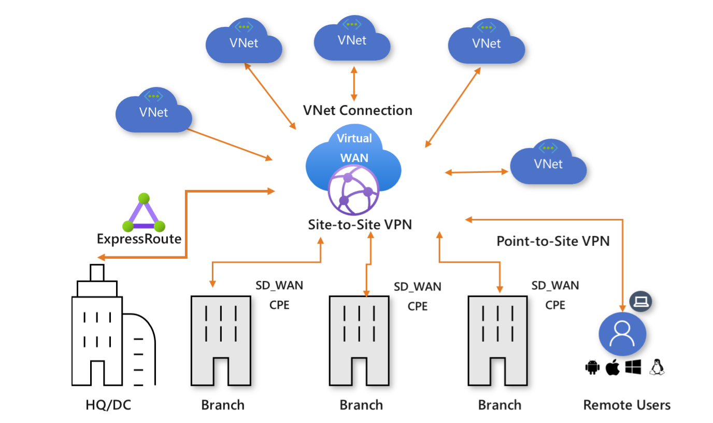
Azure Virtual WAN

Slide 32
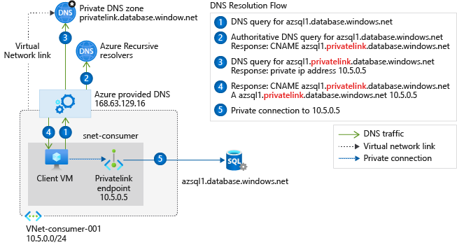
Private Link DNS Configuration

Slide 33

Azure Backup

Slide 34
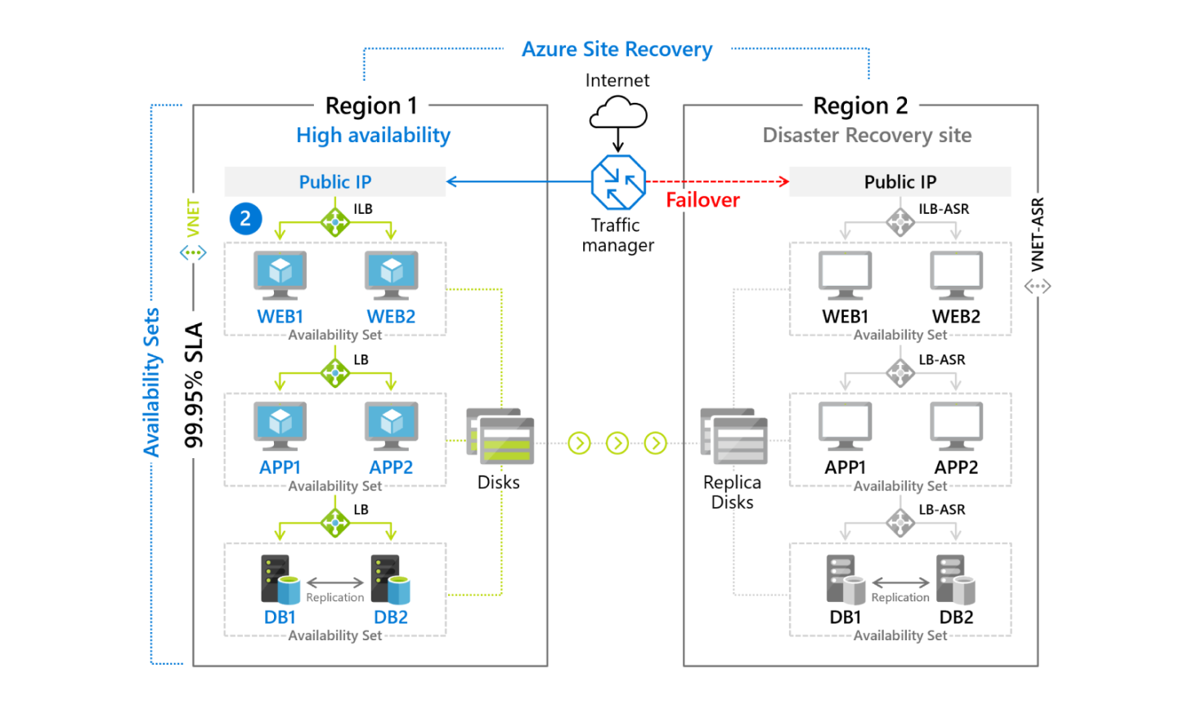
Azure Site Recovery

Slide 35

VM Scale Sets

Slide 36
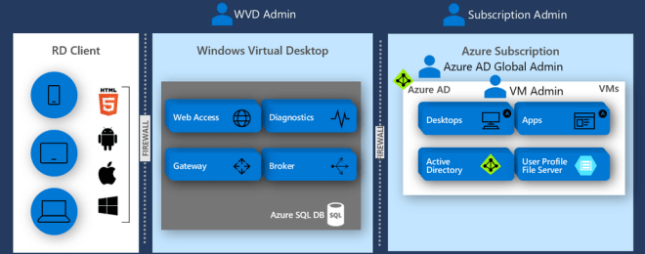
Windows Virtual Desktop (WVD)
timw.info/travis

Slide 37

Availability Set

Slide 38

Availability Zone

Slide 39

VM Networking

Slide 40

Load Balancing

Slide 41

VNet Peering

Slide 42

Hybrid Networking

Slide 43

Network Virtual Appliance

Slide 44

Azure Load Balancer

Slide 45

Application Gateway

Slide 46

Traffic Manager

Slide 47

Front Door Service

Slide 48


Docker Container Lifecycle
https://timw.info/3635f

Slide 49
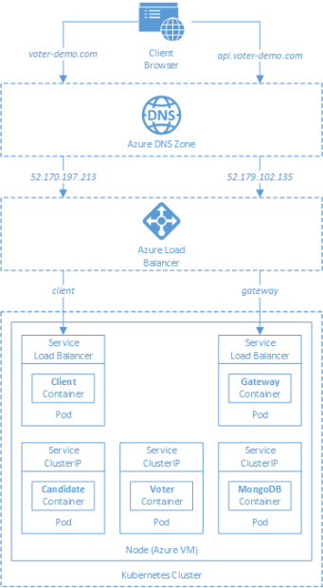
AKS

Slide 50
Azure Backup

Slide 51

Azure Site Recovery

Slide 52
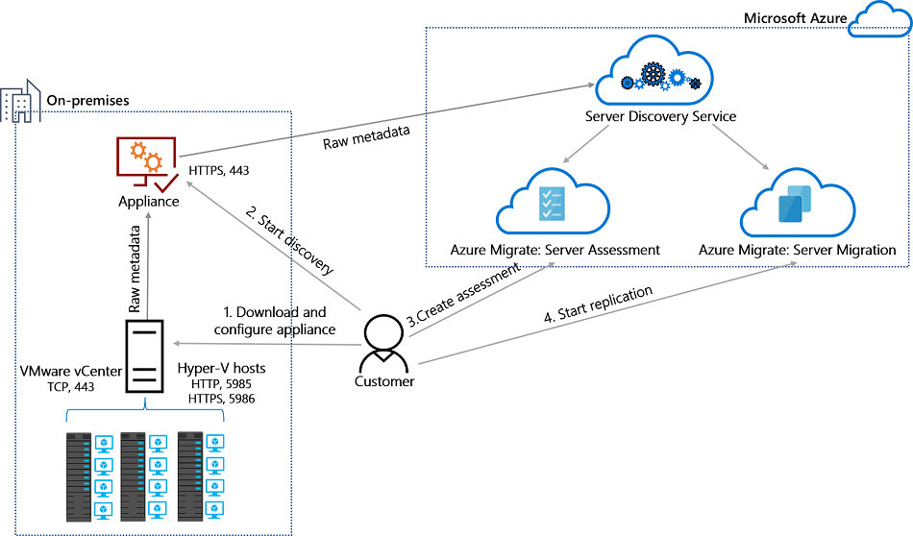
Azure Migrate

Slide 53
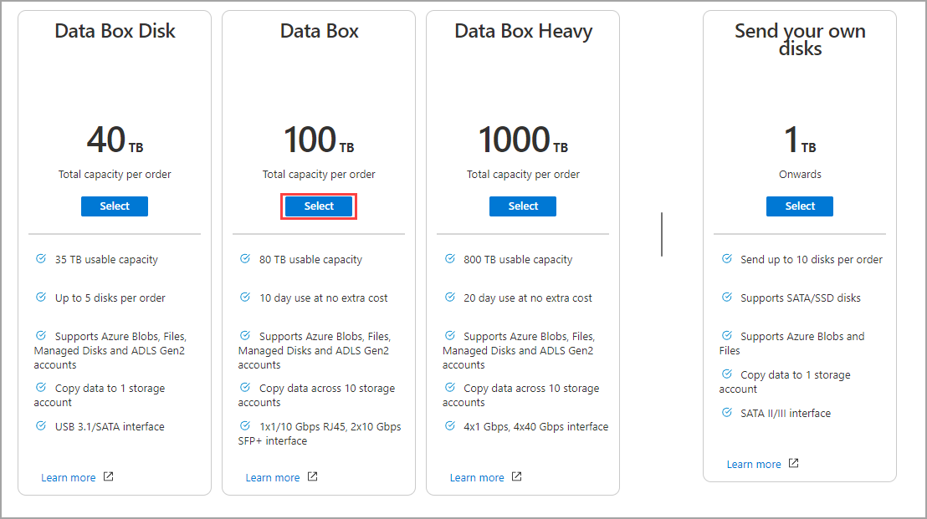
Azure Data Box

Slide 54

Data Pipelines

Slide 55
Storage Account Replication
1
3
3
2
LRS
ZRS

Slide 56
Storage Account Replication
3
3
GRS/RA-GRS

Slide 57
Storage Account Replication
1
3
1
3
2
2
GZRS – RA/GZRS

Slide 58

Always Encrypted

Slide 59
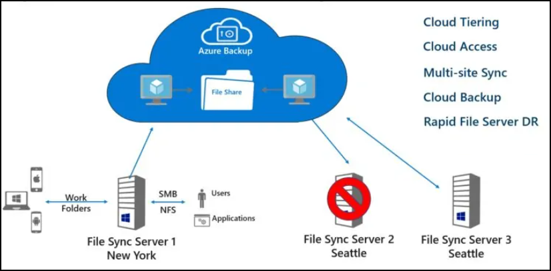
Azure File Sync

Slide 60
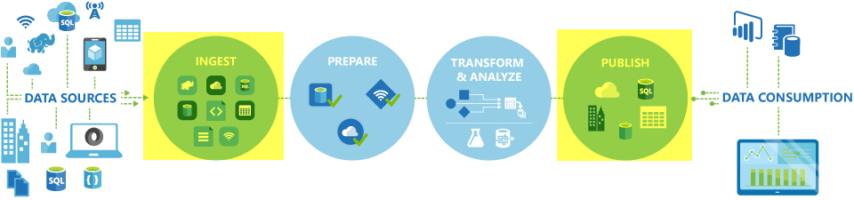
Azure Data Factory

Slide 61

Event Architecture

Slide 62

Event Architecture

Slide 63
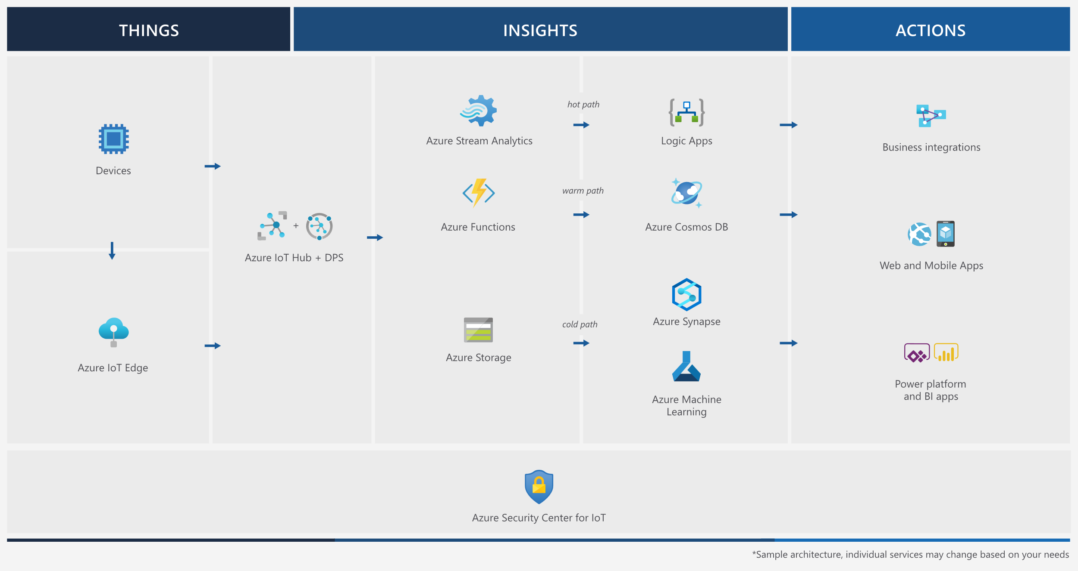
Event Architecture

Slide 64
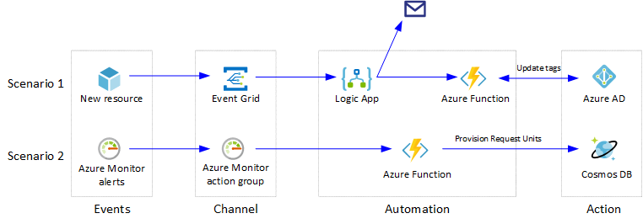
Event Architecture

Slide 65
Exam AZ-304 Item Types

Slide 66

Multiple Choice

Slide 67
Repeated Scenario
You need to move an Azure VM to another hardware host.
Solution: You redeploy the VM.
Does this solution meet the goal?
Yes
No

Slide 68

Select and Place

Slide 69

Build List and Reorder

Slide 70

Active Screen/Fill in the Blank

Slide 71

Case Study

Slide 72






Performance-Based Lab

Slide 73
Microsoft Online Testing

Slide 74
Microsoft Online Testing Process
timw.info/online

Slide 75

Microsoft Online Testing Process

Slide 76

Microsoft Online Testing Process

Slide 77

Microsoft Online Testing Process

Slide 78

Microsoft Online Testing Process

Slide 79

Microsoft Online Testing Process

Slide 80

Microsoft Online Testing Process

Slide 81

Microsoft Online Testing Process

Slide 82

Assemble the Required Materials
Webcam, microphone, and speakers
No headset
Wired or Wi-Fi Internet connection
No VPN
No tethering
Supported OS
Windows, macOS
Smartphone and ID
Mouse-based monitor
No touchscreen

Slide 83
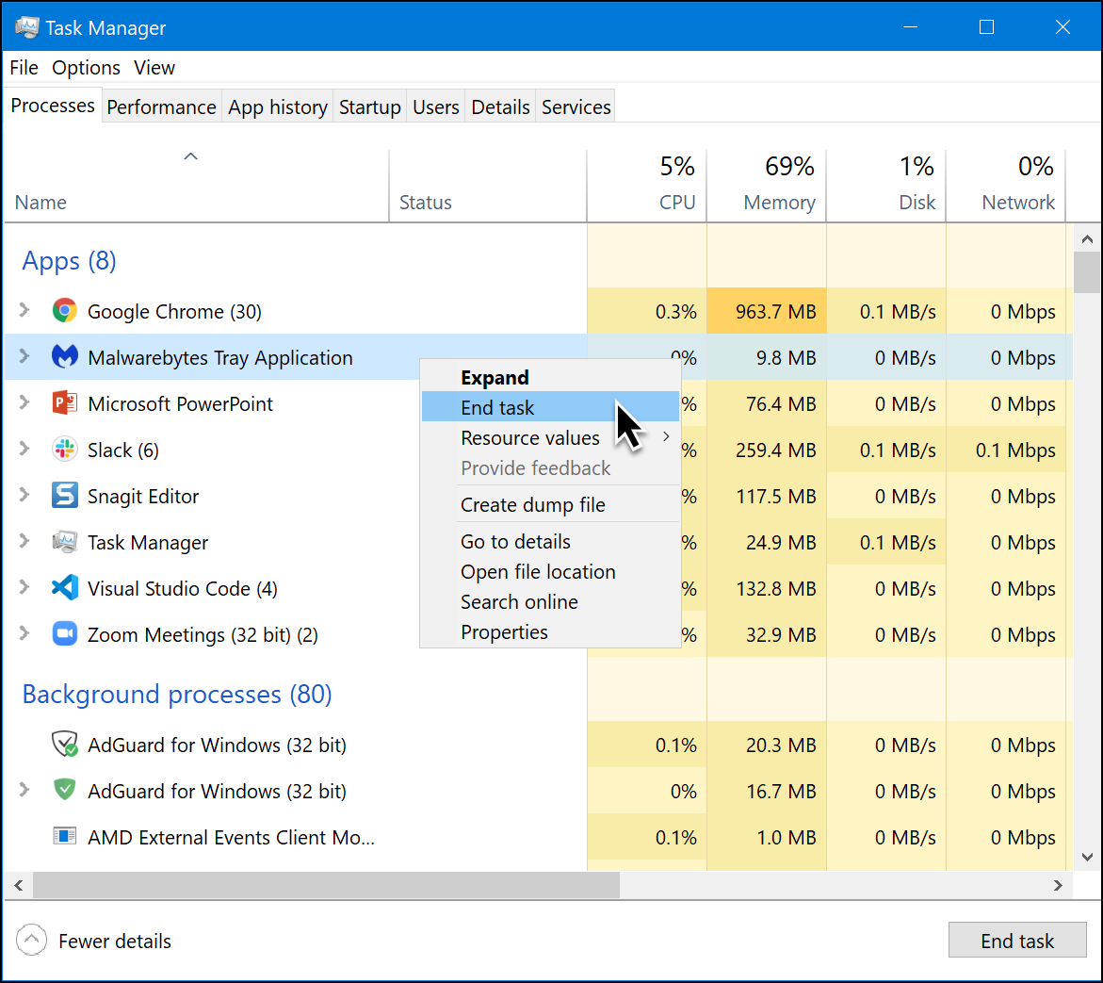
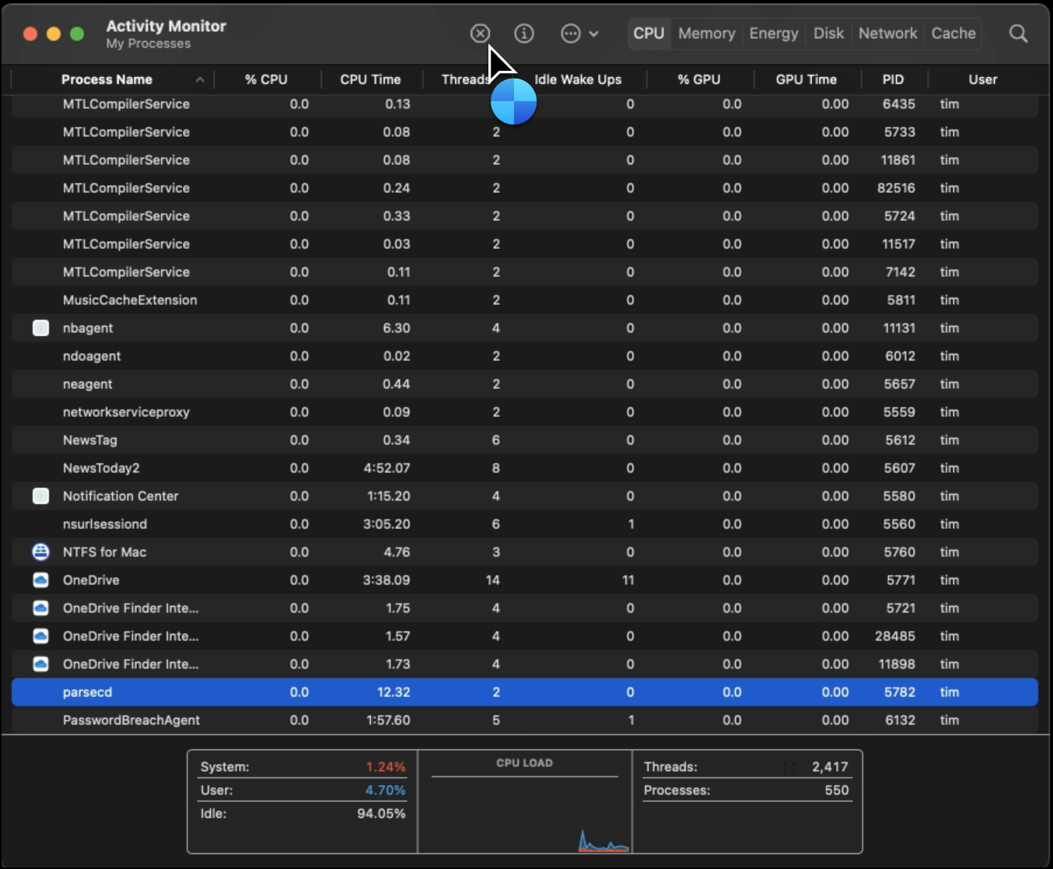
Prepare Your Testing Workstation
Windows
macOS

Slide 84
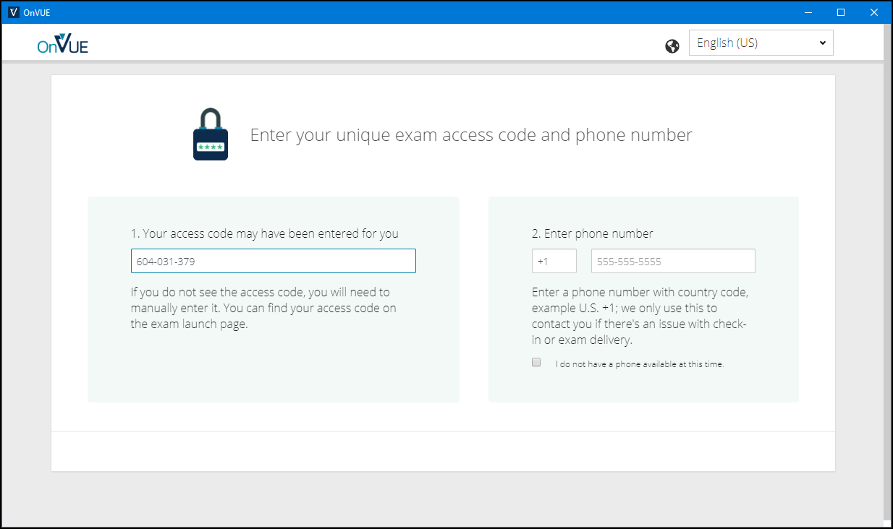
Pearson OnVUE Check-In

Slide 85
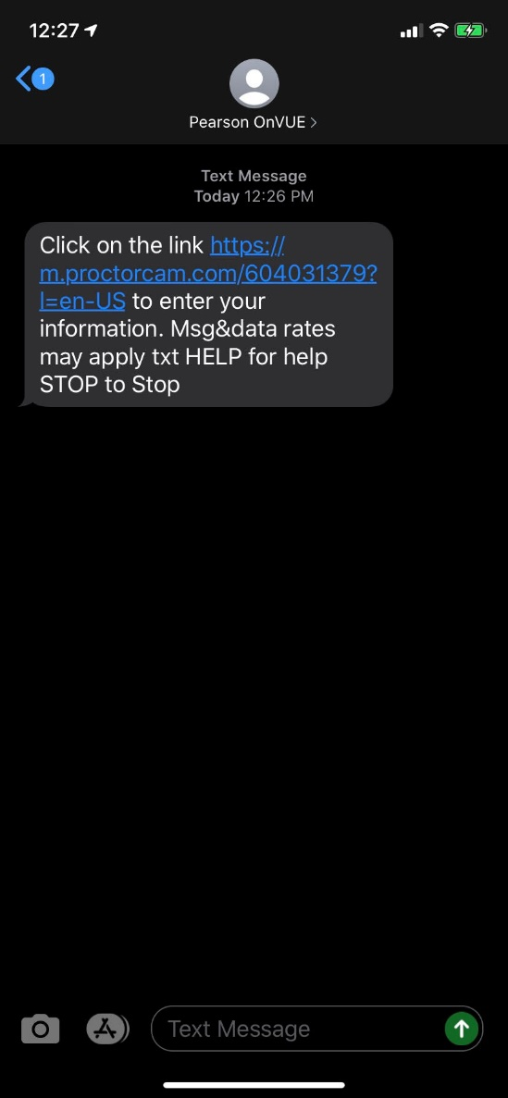
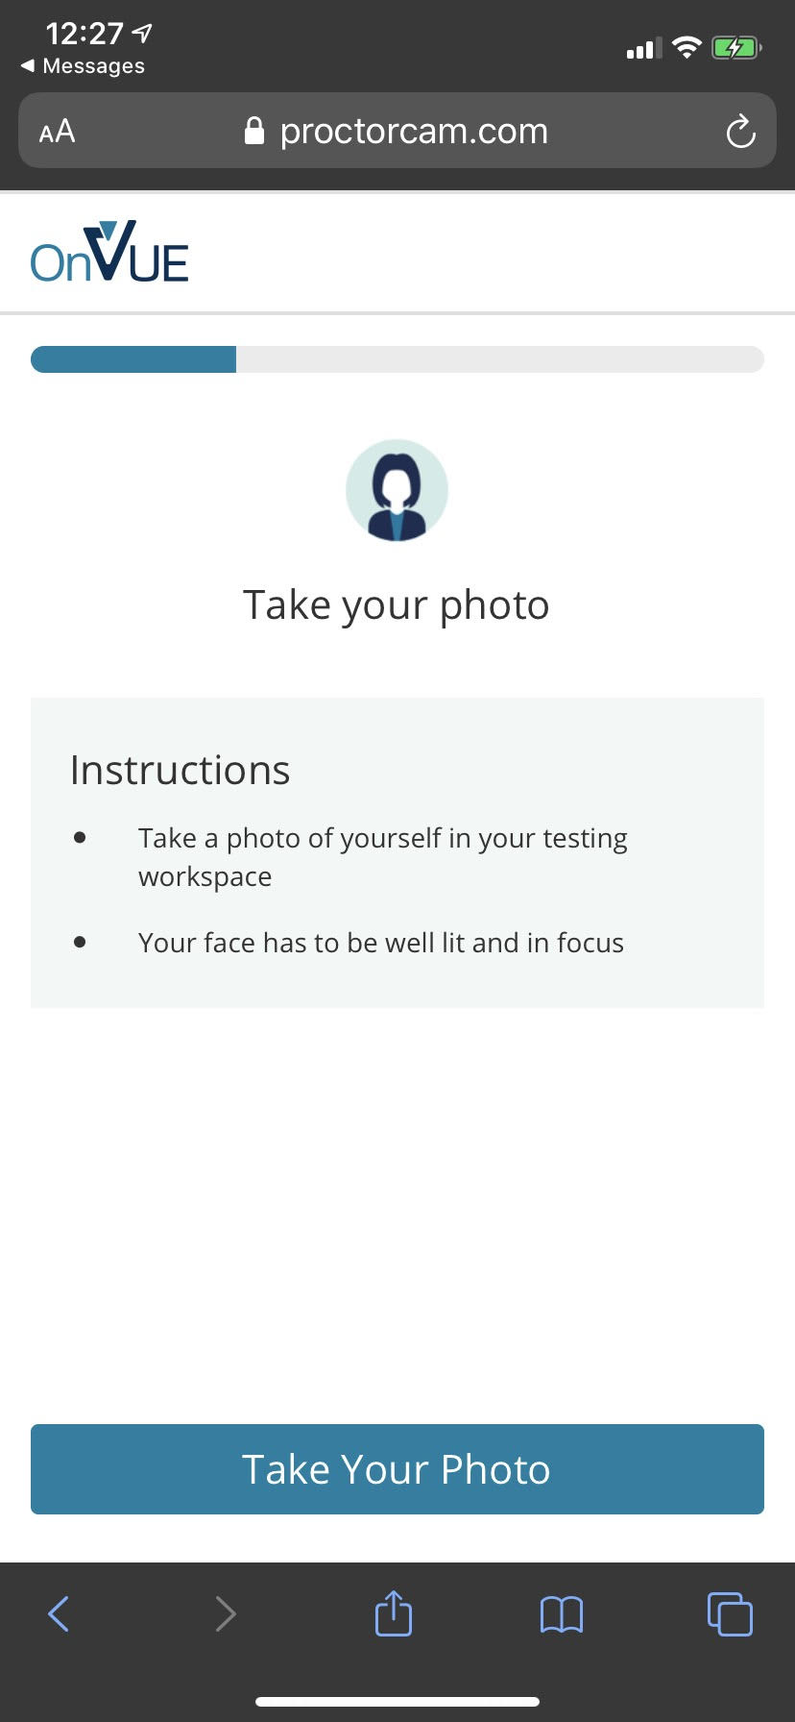
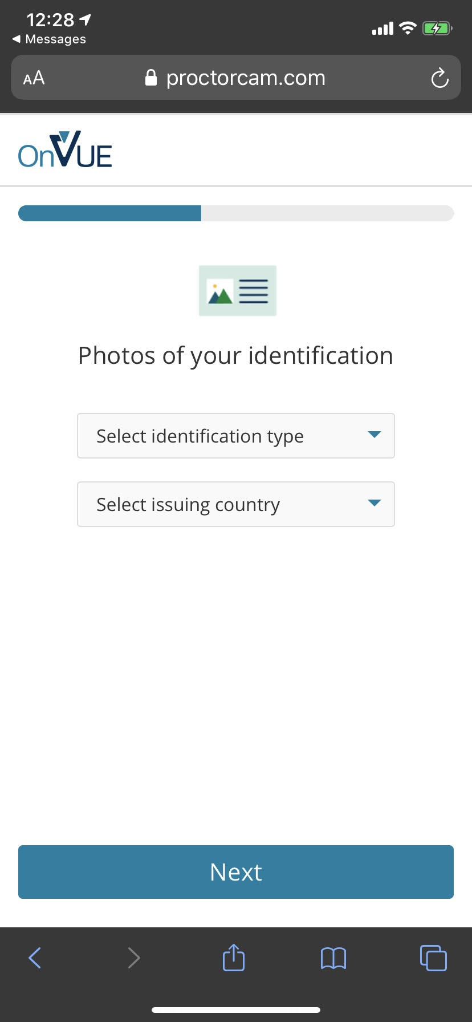
Pearson OnVUE Check-In

Slide 86
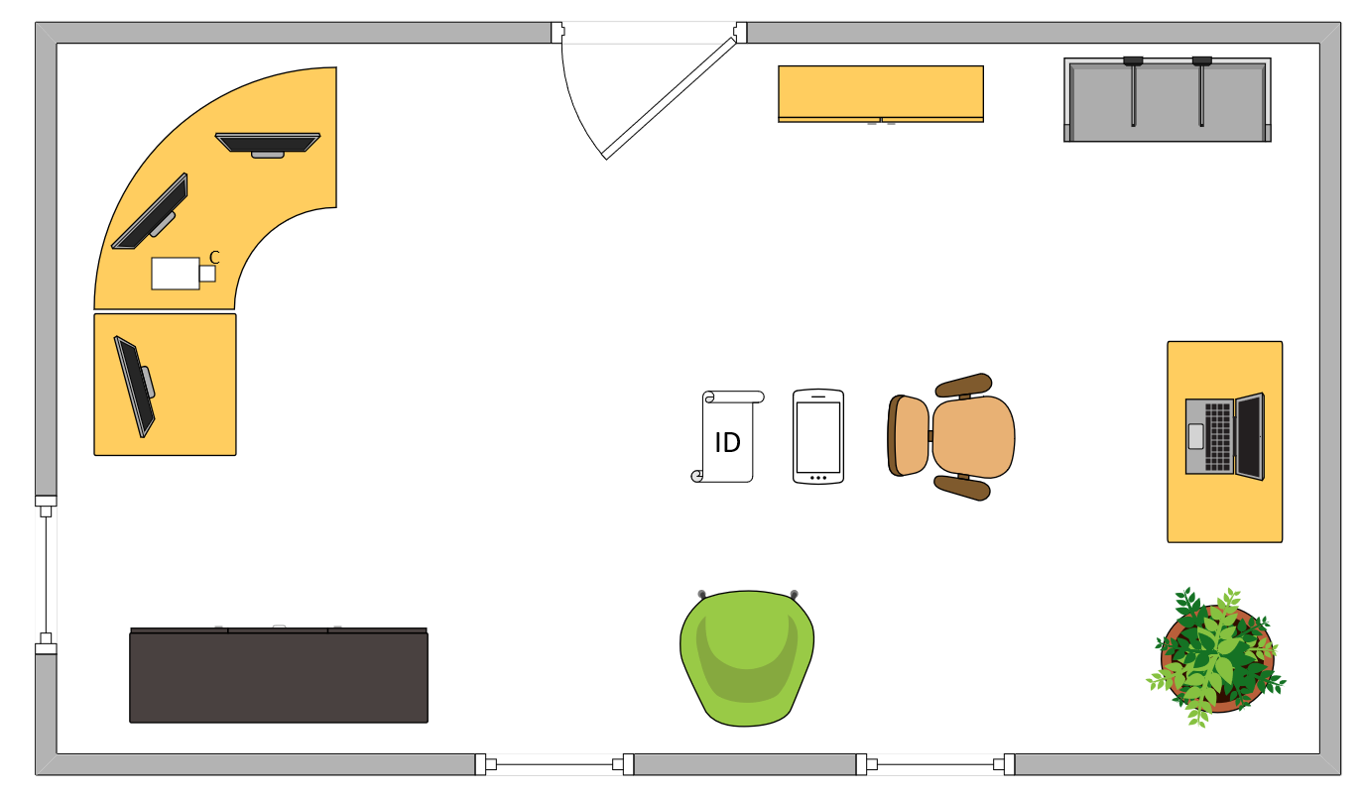
Tim’s Ideal Testing Room
No interruptions or bio breaks
Cover monitors and cameras
Pull back for environment photos
Clear table with laptop

Slide 87
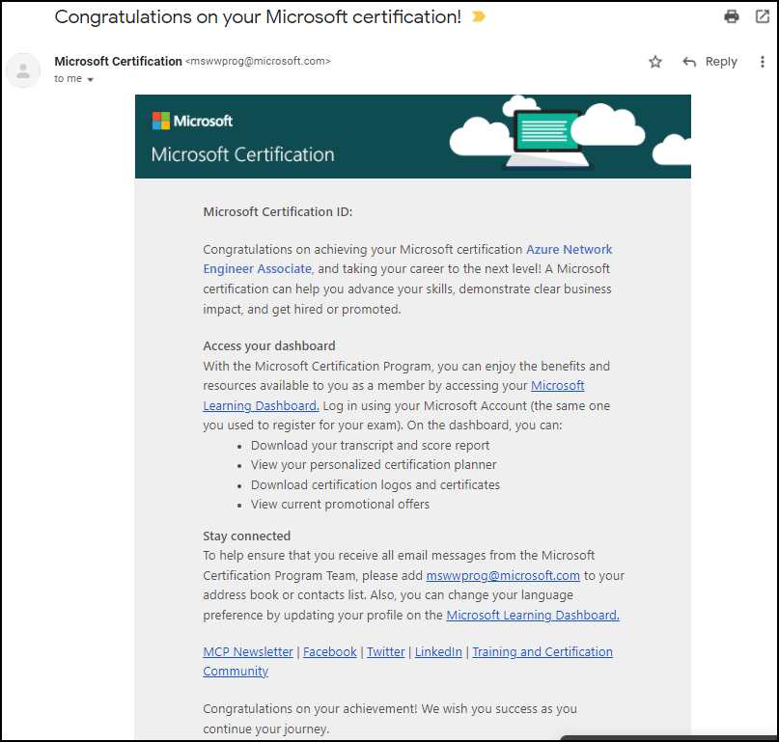
Congratulations!

Slide 88
AZ-305 Exam Strategy
Focus your skills accordingly:
60 percent Azure portal
20 percent Azure PowerShell
10 percent Azure CLI
10 percent KQL
Expect performance-based labs, but be thankful if you don't see 'em

